Slide 1
DNA Methylation and GSA approach on Methylated data
Rajni Jauhari
A2-212
Mora Lab

Slide 2
Points covered
Epigenetics
Histone and DNA Packaging
DNA Methylation
CpG Islands
GSA approach for Methylated data
R-packages and libraries

Slide 3
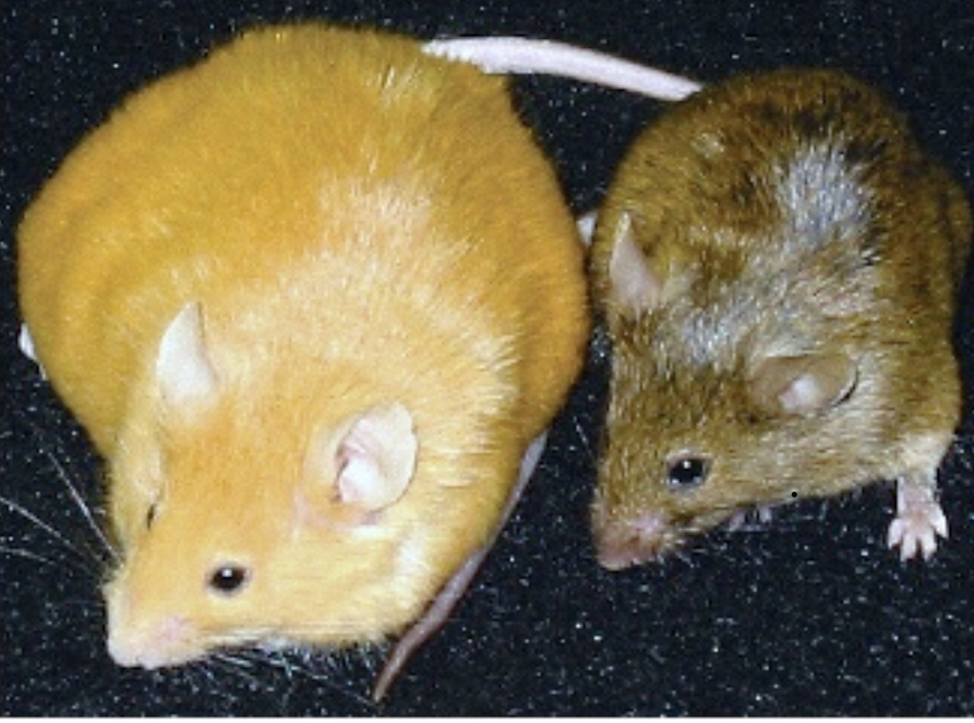
Epigenetics
Genetics alone cannot explain the diversity of phenotypes within a population
Monozygotic twins or cloned animals with identical DNA sequences can have different phenotypes and susceptibilities to disease.
Epigenetic provides additional instructions on how, where, and when the genetic information should be used.
It is defined as “The changes in gene expression that are not due to any alteration in the DNA sequence”.
Change in phenotype without genotype.
Common mechanisms includes (but not limited to)
DNA methylation
Chromatin structure modulation
X-chromosome inactivation (embryonic development)
Waterland RA,Jirtle RL.Transposable Elements: Targets for Early Nutritional Effects Effects on Epigenetic EpigeneticGene Regulation Mol Cell Biol 2003; 23: 5293‐ 5300
Notes:
Epic epigenetic stories in the animal kingdomTake the story of the "Agouti Sisters" first. In mice, Agouti is the name of a gene that contributes to their coat color. One version of agouti, agouti viable yellow, or Avy, produces either yellow, brown or mottled fur in its mouse carrier depending on its level of epigenetic methylation. Consider three mouse sisters who are genetically identical and only differ in Avy's methylation level. This piece of epigenetic difference makes the mice phenotypes drastically different. Mouse Sister Yellow has little or no methylation on Avy, lighter colored yellow fur, and is prone to cancer, obesity, and diabetes. Comparatively, Mouse Sister Brown has heavily methylated Avy gene, brown colored fur, and is lean and healthy. The third mouse, Mouse Sister Mottled, has a medium level of methylation, mottled coat mixing brown and yellow, and is less healthy than Sister Brown but healthier than Sister Yellow. Moreover, those phenotypes are actually reversible. In a 1998 study, when researchers fed a brown pregnant agouti mouse diet containing different levels of methylating molecules, they could alter the methylation of Avy, coat color, and health state of her offspring.
X-chromosome inactivation
A sperm containing an X-chromosome fertilises the egg, giving the 2 copies of X chromosome. Female do not initially require the both copies of X Chr as it would only double the amount of protein products. So paternal X chromosome is quickly inactivated during first few division. Inactive x chr (Xi) is packed and form heterochromatin. This packaging occurs due to methylation.

Slide 4
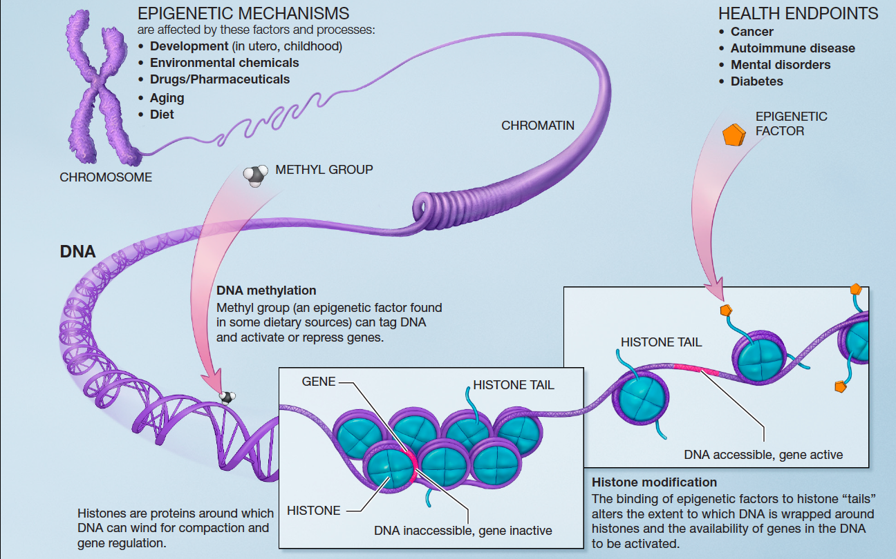
https://en.m.wikipedia.org/wiki/Epigenetics
Notes:
DNA in our cells is packed up in a condensed string, which wraps itself around proteins called histones (see figure 1). The histones bunch together into complexes called chromatins, placing some genes on the interior and making them inaccessible for transcription. When the genes need to be transcribed, the chromatins unwind, leaving the genes accessible.There are two forms of regulation that affect DNA and histones. One is histone modification, where specific molecules can bind and change the compaction pattern of histones, exposing DNA string parts that were previously hidden, or wrapping up other string parts tighter. Another is DNA methylation, an enzymatic process that works directly on the DNA by adding or removing "tags" called methyl groups to switch the genes under effect on or off. These two forms of regulation, combined with five families of histones and millions of potential methylation sites, create countless epigenetic possibilities that contribute to the diversity of our world.

Slide 5
https://cn.bing.com/images/search?view=detailV2&ccid=khhxXZtD&id=0560827195F8D19B82632530099CAD3EA528D629&thid=OIP.khhxXZtDleFylwsK18ueNAHaFJ&q=Histones+DNA+Modifications&simid=607994533698211125&selectedIndex=0
histone modification is a covalent post-translational modification (PTM) which includes :
methylation,
phosphorylation,
acetylation,
Ubiquitylation
impact on gene expression by altering chromatin structure
Role in biological processes (BP): Transcriptional activation/inactivation, chromosome packaging, and DNA damage/ repair.
Notes:
Histone acetylation occurs by the enzymatic addition of an acetyl group (COCH3) from acetyl coenzyme A. The process of histone acetylation is tightly involved in the regulation of many cellular processes including chromatin dynamics and transcription, gene silencing, cell cycle progression, apoptosis, differentiation, DNA replication, DNA repair, nuclear import, and neuronal repression. The modifying enzymes involved in histone acetylation are called histone acetyltransferases (HATs) and they play a critical role in controlling histone H3 and H4 acetylation.
Acetylation of the lysine residues at the N-terminus of histone proteins remove charges, thereby reducing the affinity between histones and DNA. This makes RNA polymerase and TFs easier to access the promoter region
Histone deacetylaces (HDACs) catalyze the hydrolytic removal of acetyl groups from histone lysine residues. An imbalance in the equilibrium of histone acetylation has been associated with tumorigenesis and cancer progression.
So, histone Acetylation enhances transcription while histone deacetylation represses transcription.
Phosphorylation
histone kinases transfer a phosphate group from ATP to the hydroxyl group of the target amino-acid side chain. In doing so, the modification adds significant negative charge to the histone that undoubtedly influences the chromatin structure.
Histone methylation mainly occurs on the side chains of lysines and arginines. Unlike acetylation and phosphorylation, however, histone methylation does not alter the charge of the histone protein.
The addition of ubiquitin to a substrate protein is called ubiquitination or less frequently ubiquitylation. Ubiquitination affects proteins in many ways: it can mark them for degradation via the proteasome, alter their cellular location, affect their activity, and promote or prevent protein interactions

Slide 6
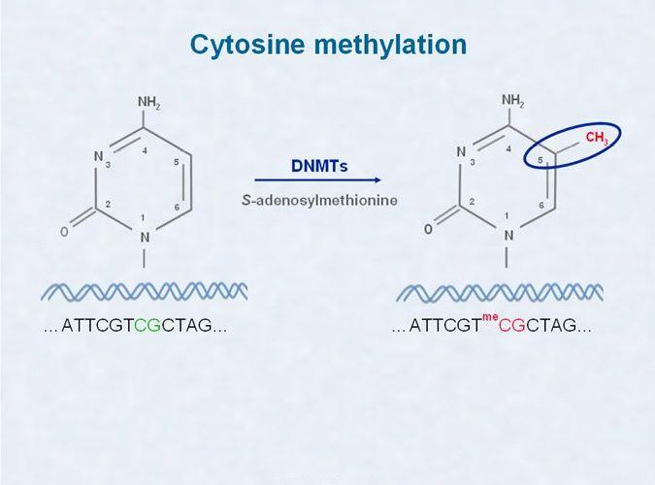
DNA Methylation
important for normal development in higher organisms
addition of a methyl group to the number 5th carbon of the cytosine, to convert cytosine to 5-methylcytosine.
In humans, DNA methylation occurs dinucleotide CpGs.

Slide 7
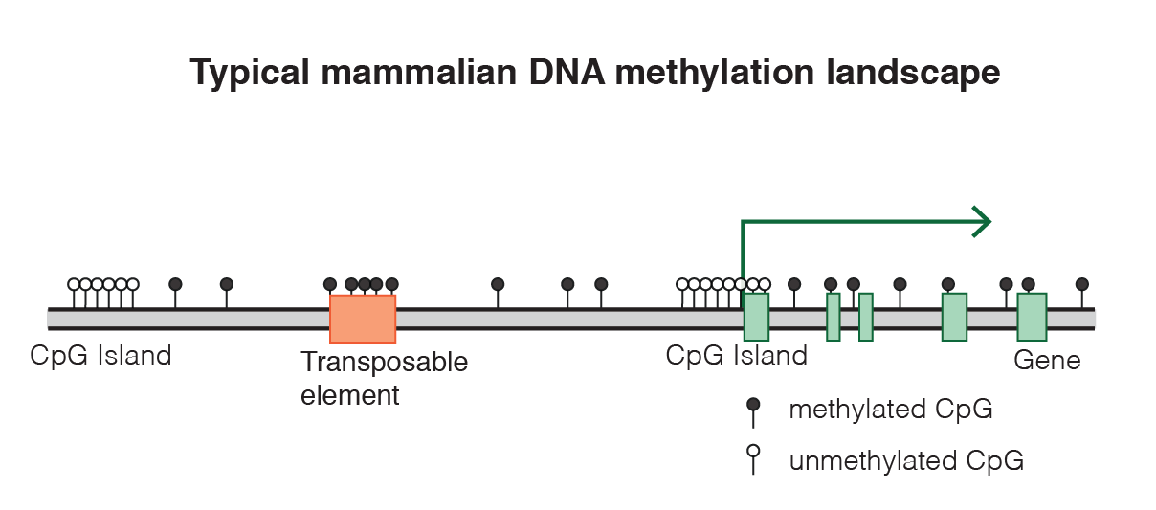
https://en.m.wikipedia.org/wiki/DNA_methylation
Post-transcriptional gene silencing - destroyed RNA of a gene which prevents translation by mechanism RNA interference (RNAi) through siRNA which instruct proteins to the targeted messenger RNA (mRNA) and "cleaves" them.
Gene silencing also protect the organism’s genome from transposons and viruses.

Slide 8
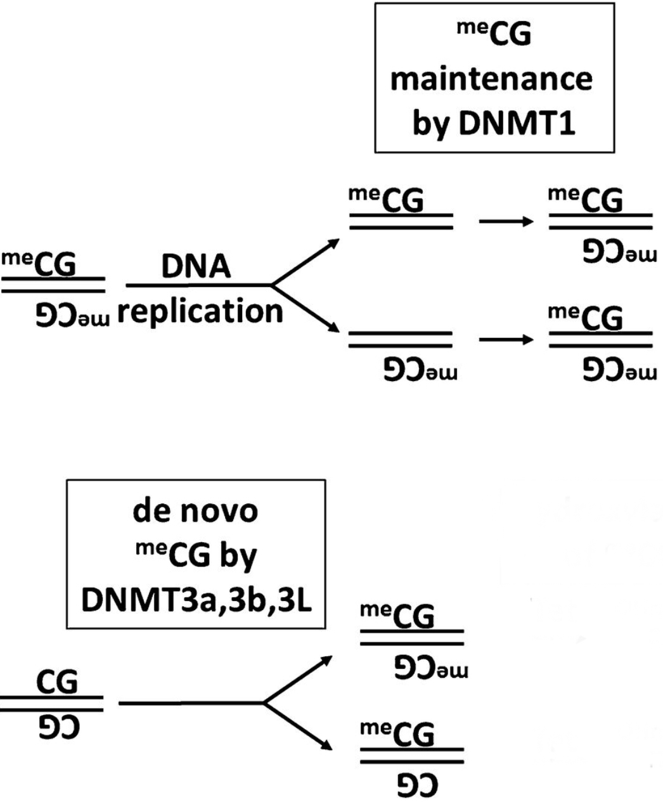
Enzymes involved in methylation
DNA METHYLTRANSFERASES(DNMTs)
In Mammals,
DNMT1 – Maintainance methylase
DNMT3a.
DNMT3b - ‘de novo’ methylases
Environmental Influences on Epigenetic Gene RegulationCamille Fung, Robert A. McKnight, Robert H. LaneNeoReviews Mar 2013

Slide 9
CpG Sites and CpG islands
Around 60-90% of CpGs are methylated in mammals. DNA methylation frequently occurs in repeated sequences, and may help to suppress junk DNA and prevent chromosomal instability.
There are regions of the DNA that have a higher concentration of CpG sites (> 60%), named the CpG islands, which tend to be located in the promoter regions of many genes.
Methylation of CpG islands dysregulate gene transcription through the inhibition of transcription factor either directly or via altered histone modification.
The CpG islands are usually not methylated.
Length > 200bases
C+G content >50%
CpG ratio obs./esp. >0.6

Slide 10
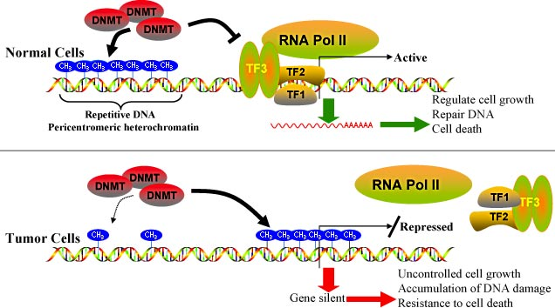
Baylin et al. 2001; Jones et al. 2002
Baylin et al. 2001; Jones et al. 2002

Slide 11
Function of DNA Methylation
DNA methylation is important in:
Transcriptional gene silencing
Maintain genome stability
Genomic imprinting
X chromosome inactivation (females)
Notes:
X-inactivation (also called lyonization) is a process by which one of the copies of the X chromosome present in female mammals is inactivated. The inactive X chromosome is silenced by it being packaged in such a way that it has a transcriptionally inactive structure called heterochromatin. As nearly all female mammals have two X chromosomes, X-inactivation prevents them from having twice as many X chromosome gene products as males, who only possess a single copy of the X chromosome (see dosage compensation). The choice of which X chromosome will be inactivated is random in placental mammals such as humans, but once an X chromosome is inactivated it will remain inactive throughout the lifetime of the cell and its descendants in the organism

Slide 12
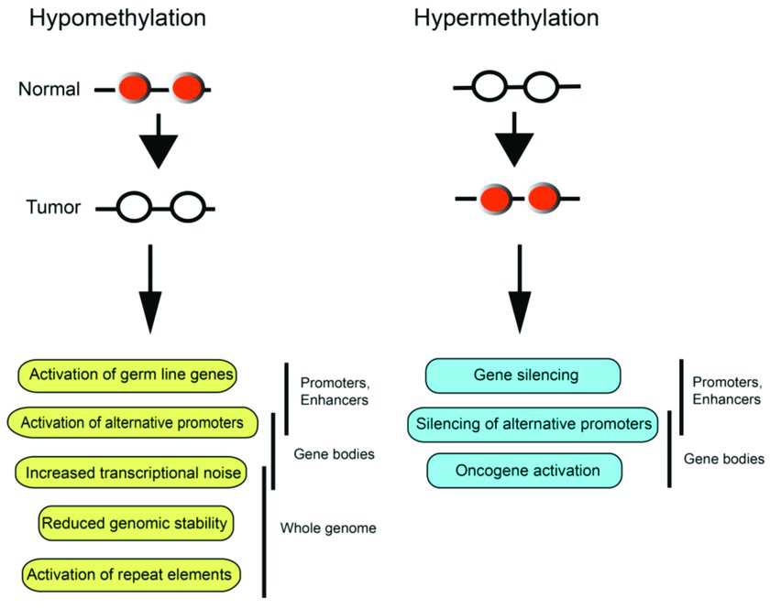
DNA Methylation and Cancer
Hypomethylation – decrease methylation levels
Global hypomethylation of DNA sequences that are normally heavily methylated may result in
Chromosomal instability
Increased transcription from transposable elements
An elevated mutation rate due to mitotic recombination
Promoter region CpG islands demethylation of proto-oncogenes will activate the repressed gene expression
Hypermethylation – increase methylation levels
Hypermethylation of the CpG island promoter can inactivate tumor-suppressor genes, affect genes involved in the cell cycle, DNA repair, and the metabolism of carcinogens, all of which are involved in the development of cancer.
Pfeifer, Gerd. (2018). Defining Driver DNA Methylation Changes in Human Cancer. International Journal of Molecular Sciences. 19. 1166. 10.3390/ijms19041166.

Slide 13
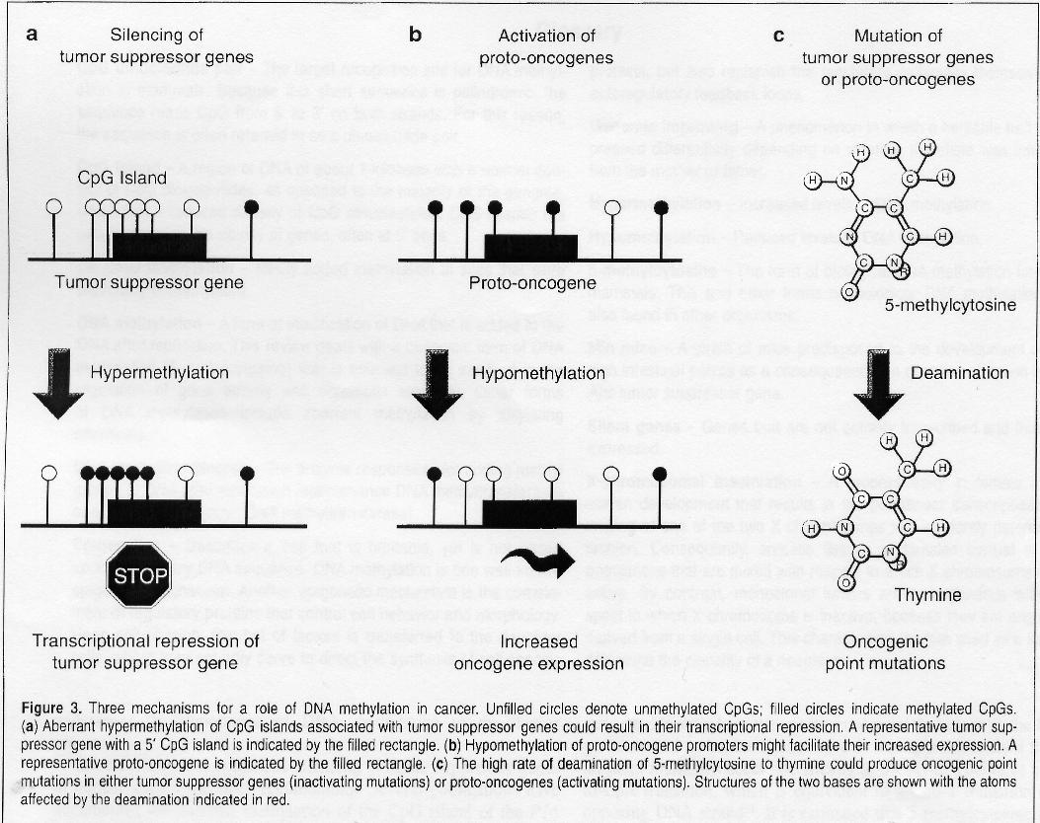
Laird PW, 1997
Laird PW, 1997

Slide 14
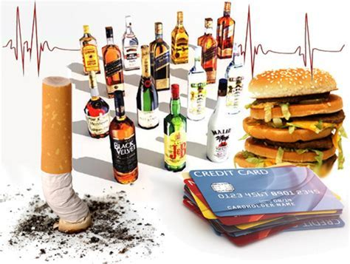
Most “heritable” diseases
are influenced by the environment
Food
Infections
Trauma
Toxins
Life style
Aging
Metal exposure
Tobacco Smoking
Alcohol Drinking
Notes:
14

Slide 15
Papers on GSA approach for Methylated data
Belinda Phipson, Jovana Maksimovic, Alicia Oshlack; missMethyl: an R package for analyzing data from Illumina’s HumanMethylation450 platform, Bioinformatics, Volume 32, Issue 2, 15 January 2016.
Paul Geeleher, Lori Hartnett, Laurance J. Egan, Aaron Golden, Raja Affendi Raja Ali, Cathal Seoighe; Gene-set analysis is severely biased when applied to genome-wide methylation data, Bioinformatics, Volume 29, Issue 15, 1 August 2013

Slide 16
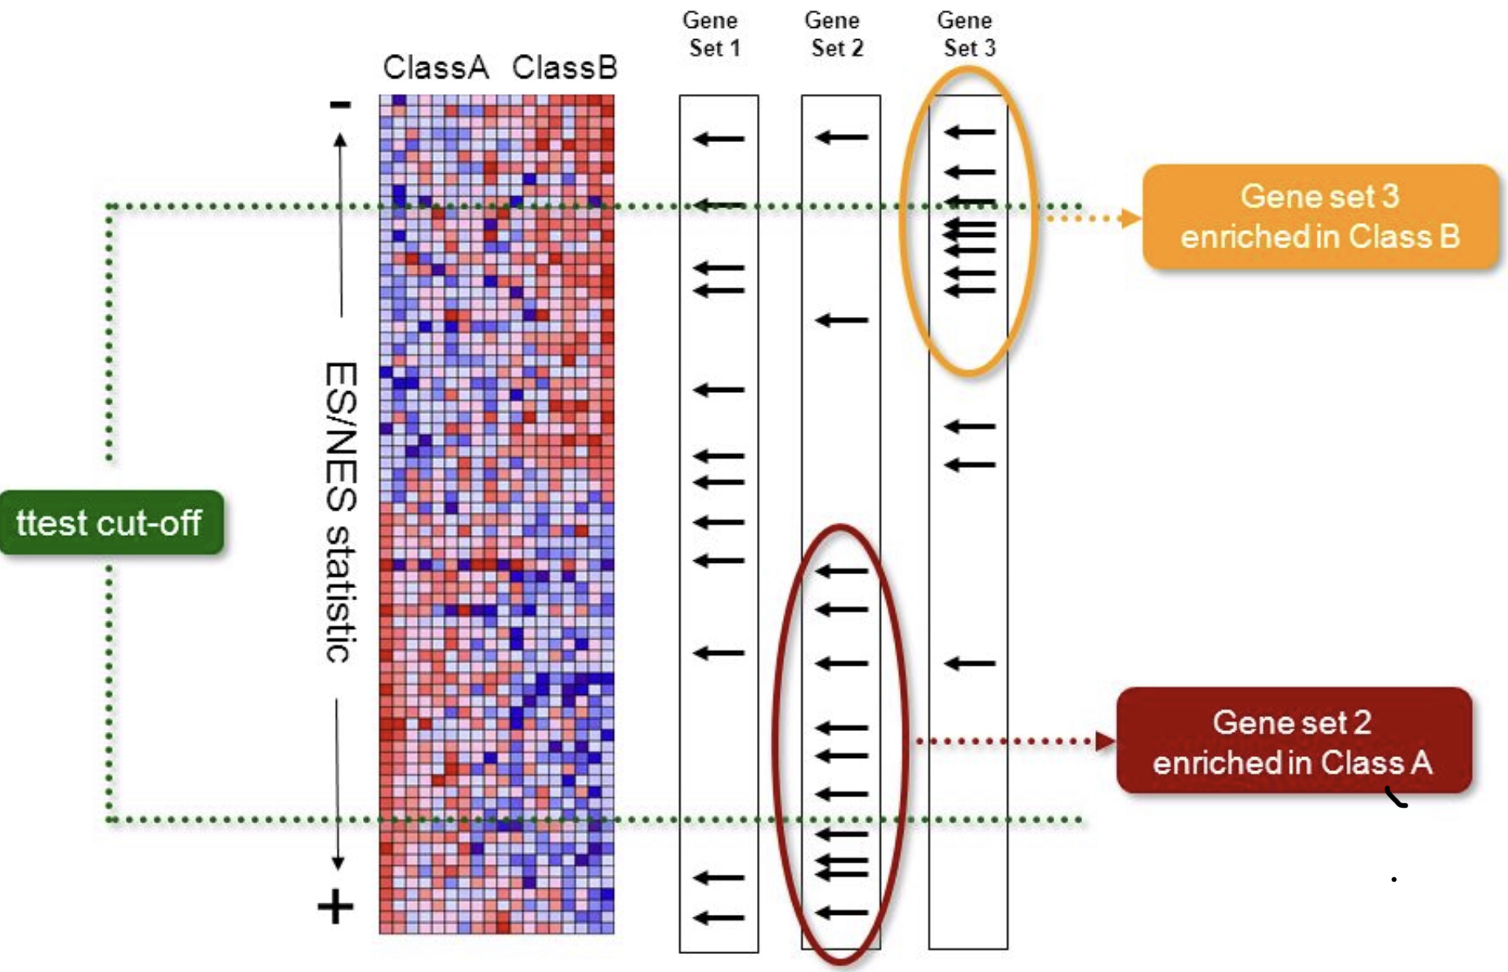
GSA approach Issues
significant result of GSA for a gene set is interpreted as evidence that the corresponding biological function or process is affected in the experimental condition or treatment.A key assumption is that all genes have, a priori, the same probability of appearing in the list. If this is not true, that is, if certain classes of genes are more likely to appear in the list, regardless of the treatments or conditions being investigated, this has the potential to cause misleading results from GSA. The application of GSA to lists of genes found to be affected by such a bias.
In RNA seq, data longer and more highly expressed genes (which tend to have more mapped reads) are more likely to be identified as differentially, expressed. The lengths and expression levels of genes frequently differ between gene sets, resulting in some gene sets wrongly appearing to be enriched among the differentially expressed genes
Paul Geeleher et. al ; Gene-set analysis is severely biased when applied to genome-wide methylation data

Slide 17
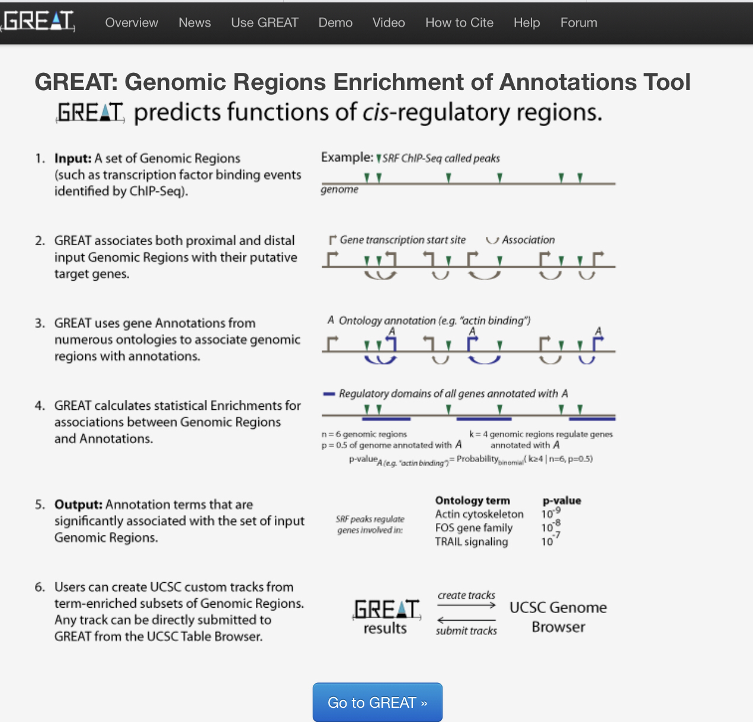
Similarly in ChIP-Seq data, when distal binding sites are included in the analysis. GSA may be confounded when genes in different gene sets are repre-sented by different proportions of the genome.
Caliberate
IMPORTANT to note
Methylation of only one CpG site can perturb expression.
Methylated data
Notes:
not suitable for analysis of methylation data, as it cannot differentiate between one gene in a set with many highly differentially methylated CpG sites or many genes in the same set with one highly differentially methylated CpG site each.

Slide 18
Biased GSA approach for Methylated data
Helman et al. (2012) called a gene is differentially methylated when two nearby probes (allowing one intervening probe) both showed at least a 2-fold difference in methylation between the sample groups. Given this criterion, genes (for example, SOCS4) that have only two associated probes will be tested just once for differential methylation. By contrast, PPP2R3B, which has 197 associated probes, is tested nearly 400 times. Clearly, PPP2R3B is far more likely to give false-positive results.
Kalari et al. (2012) used a peak calling method to identify regions that appeared enriched for methylation; however, because of the different numbers of probes associated with each gene. More peaks on genes with many associated probes.

Slide 19
Gostats for Hypermethylated gene sets
Rauch et al. (2008) used Human CpG Island microarray to assess methylation in five lung cancer samples compared with normal lung tissue applied GSA to identify hypermethylated gene sets in this dataset.
CpG islands = hypermethylated in a sample ‘when at least two adjacent probes, within the CpG island scored a fold difference factor > 2.
R package GOstats to assess methylation of GO biological processes containing between 100 and 1000 genes
The enrichment P-value strongly correlated with the mean number of probes per gene(important to differences between gene sets in the number of probes per gene).

Slide 20
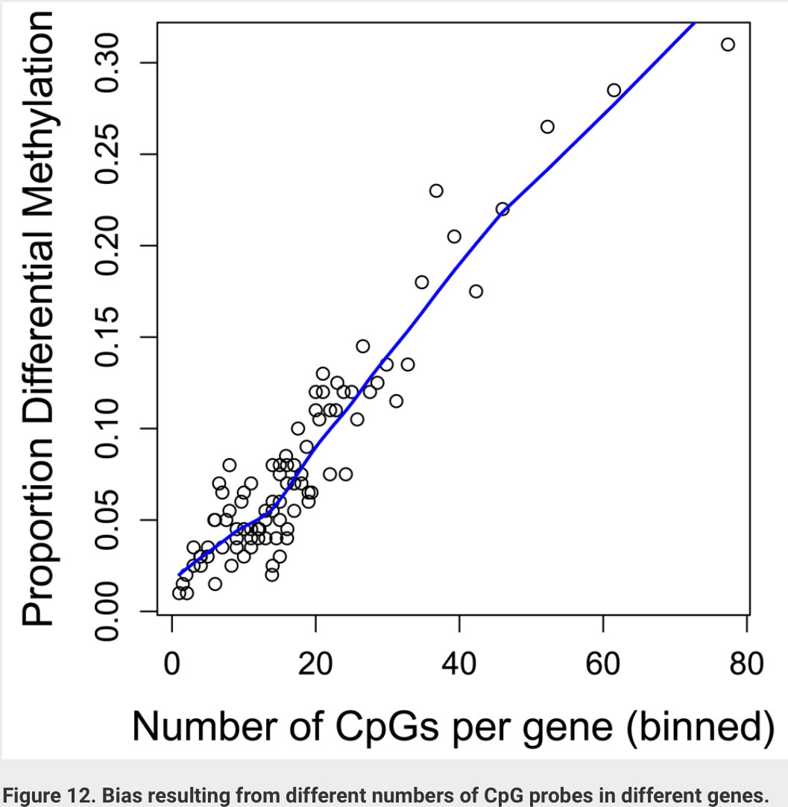
Understanding Biasness
100 random permutations of the probe log intensity values within each sample followed by GSA.
Modified fold change cut-off for differential methylation because the methylation status of adjacent CpG sites is correlated in the real data resulting in a higher probability of adjacent CpG sites showing differential methylation between groups.
this application should not reveal any same significant results in the permuted data, as each gene was associated with a random set of probes.
BUT many of the same gene sets were found to be highly significant.
Maksimovic J, Phipson B and Oshlack A. A cross-package Bioconductor workflow for analysing methylation array data, F1000Research 2017, 5:1281(doi: 10.12688/f1000research.8839.3

Slide 21
Understanding Biasness…
Another approach
permutation of sample labels i.e random groupings of the samples, by inverting the fold change values for each pair of samples ( five pairs of samples = 32 possible configurations).
For each permutation, genes were ranked by methylation fold change of the most differentially methylated probe and then applied GSA.
Again the same gene sets that were reported in the original analysis also seem to be enriched for the inverted datasets.

Slide 22
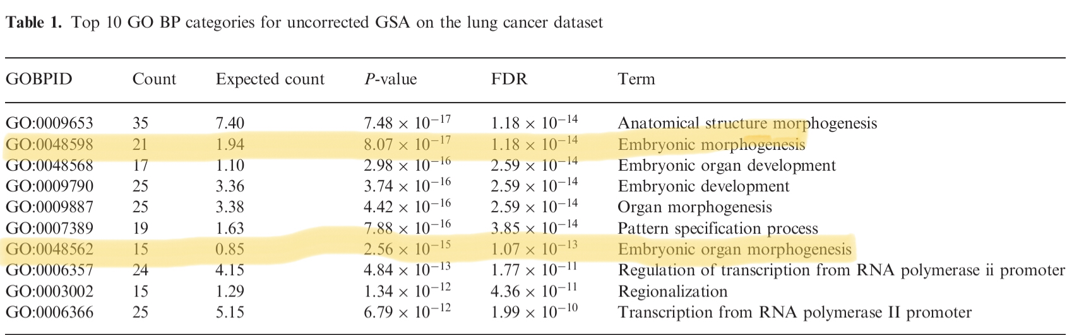
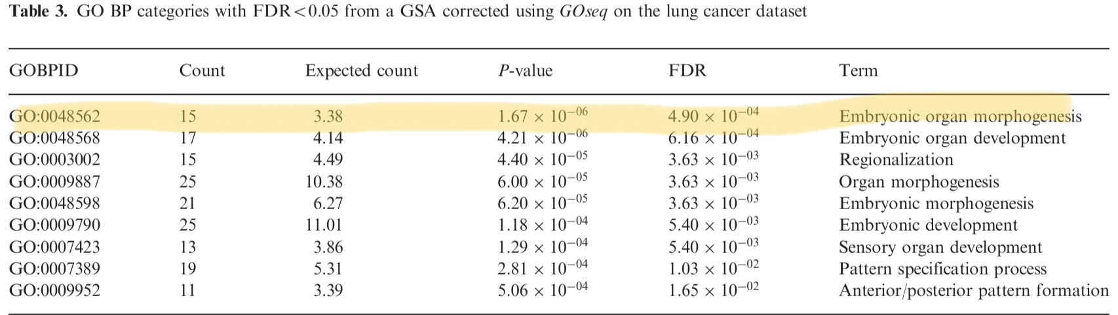
R- Package-GOseq
Now, Bioconductor package GOseq (Young et al., 2010) used to control for the fact that different genes have different probabilities of appearing in the foreground list.
To control for bias in GSA applied to a six knot mono- tonic spline function to model the association between hypermethylated genes and the value of the confounding variable (CpG probes associated with the gene).
Predict the probability of hypermethylated genes as a function of the number of associated probes.
Notes:
In the lung cancer dataset, the number of GO BP categories that were significantly enriched (FDR<05) after correction was much smaller than previously (9, compared with 72). After correction (Table 3), ‘Embryonic organ morphogenesis’ was the most significant category (P ¼ 4.9104, compared with P ¼ 8.11017, before correction). The expected number of hypermethylated genes for ‘Embryonic organ morphogenesis’ rose from 1.9 to 3.4, but this is still considerably fewer than the observed number of hypermethylated genes for this category, which is 15. This suggests that the reported hypermethylation of developmental associated genes in this lung cancer dataset is not an artifact of the higher numbers of associated probes. However, several of the gene sets identified in the original analysis are no longer significant.

Slide 23
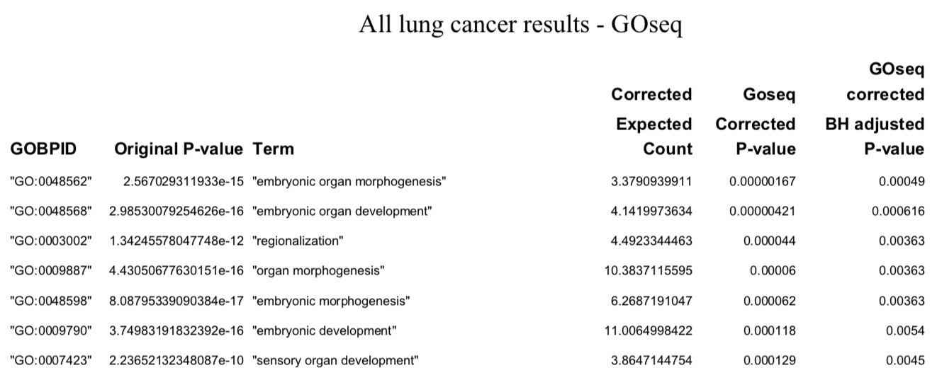
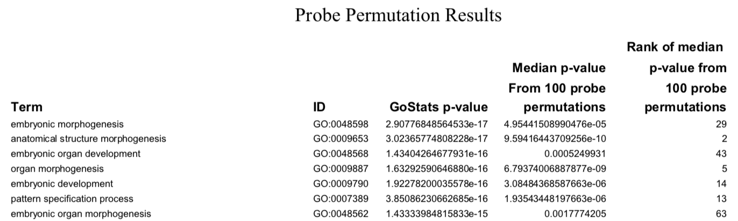
The spline is shown as solid black line. The points show the hypermethylated genes in bins of minimum size 100 genes.

Slide 24
Ulcerative Colititis dataset
uncorrected GSA – many highly significant gene sets.
After correction using sample label permutations, 19 gene sets were identified with P50.05.
GSA corrected by GOseq identified 12 gene sets compared with 262 when using an uncorrected approach.
Out of 12 gene sets 11 were also identified by sample label permutation.
Goseq – Better but statistical significance (by a permutation method) limited because of the relatively small sample sizes for genome-wide methylation experiments.
Notes:
Good evidence that the corrected GSA performs well and is a suitable method of accounting for bias in methylation data.

Slide 25
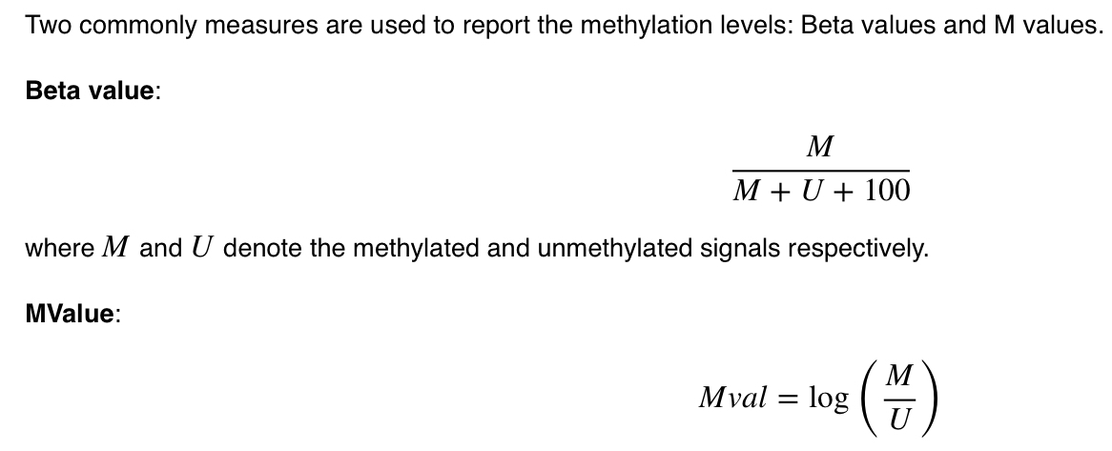
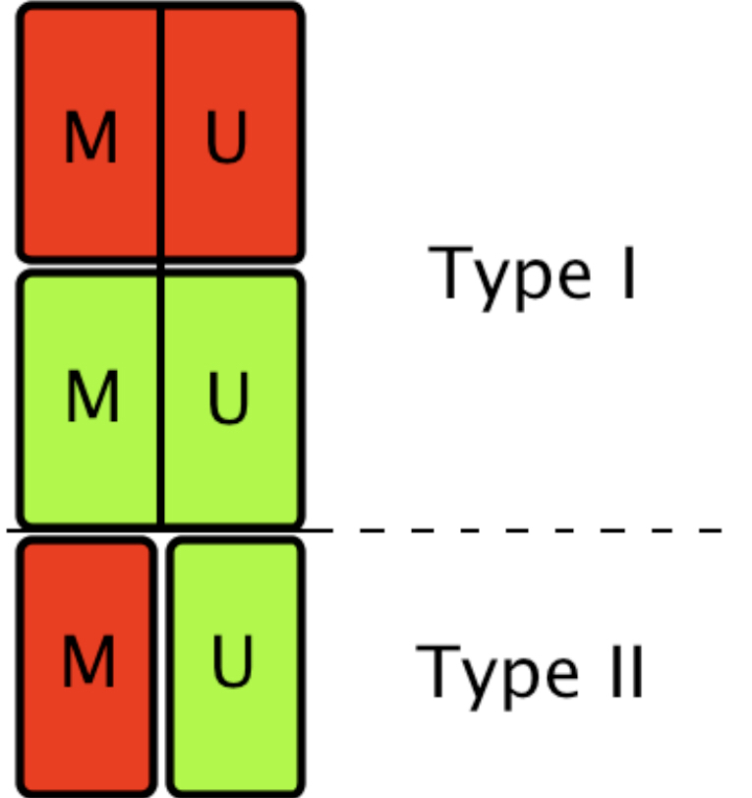
R- Package- missMethyl
dedicated tools for analyses at HumanMethylation450 BeadChip ( profile >450 000 CpGs across the human genome)
methods :normalization -> removal of unwanted variation (RUV) -> differential variability testing -> GSA.
Software packages: minfi (Aryee etal., 2014), methylKit (Akalin etal., 2012) and methylumi.
Jean-Philippe Fortin, Kasper Daniel Hansen, Analysis of 450k data using minfi
Notes:
HumanMethylation450 BeadChip is a cost-effective way to profile >450 000 CpGs across the human genome, making it a popular platform for profiling DNA methylation

Slide 26
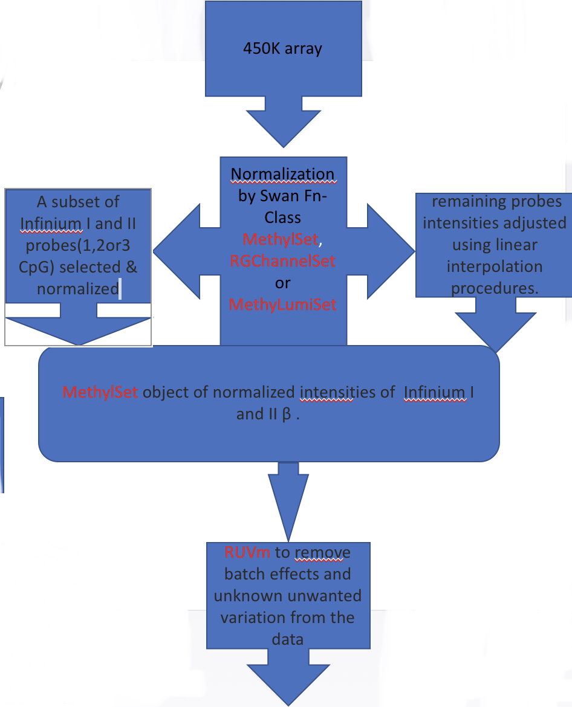
Reading data into R
> library(missMethyl)
> library(limma)
> library(minfi)
> library(minfiData)
>rgSet <- read.metharray.exp(targets = targets)
Subset-quantile within array normalization (SWAN)
>Set <- preprocessRaw(rgSet)
>mSetSw <- SWAN(mSet,verbose=TRUE)
Filter out poor quality probes
>detP <- detectionP(rgSet)
>keep <- rowSums(detP < 0.01) == ncol(rgSet)
>mSetSw <- mSetSw[keep,]
Extracting Beta and M-values
>meth <- getMeth(mset_reduced)
>unmeth <- getUnmeth(mset_reduced)
>Mval <- log2((meth + 100)/(unmeth + 100))
>beta <- getBeta(mset_reduced)
Testing for differential methylation
>group <- factor(targets$status,levels=c("normal","cancer"))
># Limma package
>fit.reduced <- lmFit(Mval,design)
>fit.reduced <- eBayes(fit.reduced)
>summary(decideTests(fit.reduced))

Slide 27
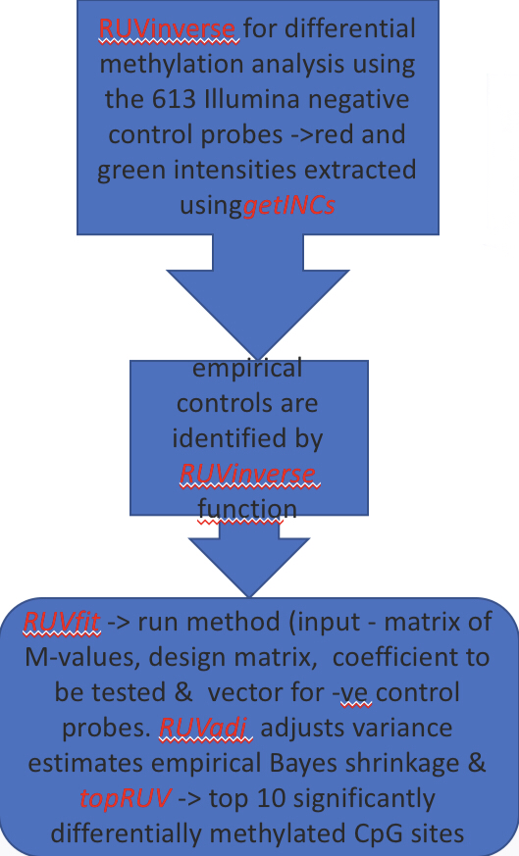
Removing unwanted variation(RUV)
# get M-values for ALL probes
>meth <- getMeth(mSet)
>unmeth <- getUnmeth(mSet)
>M <- log2((meth + 100)/(unmeth + 100))
>INCs <- getINCs(rgSet)
>Mc <- rbind(M,INCs)
# Stage analysis 1
>rfit1 <- RUVfit(data=M, design=des, coef=2, ctl=ctl)
>rfit2 <-RUVadj(rfit1)
# Stage analysis 2- ECP to perform 2nd dM
>rfit1 <- RUVfit(data=M, design=des, coef=2, ctl=ctl)
>rfit2 <-RUVadj(rfit1)

Slide 28
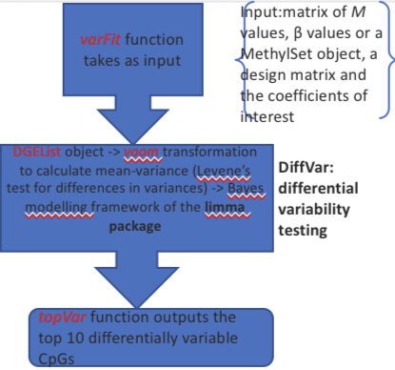
Testing for differential variability (DiffVar)
>grp <- factor(target $status, levels = c(”normal”, “cancer”))
>fitvar <- varFit(Mval, design = design, coef = c(1,4))
>contr <- makeContrasts(groupcancer-groupnormal, levels=colnames(design2))
>fitvar.contr <- contrasts.varFit(fitvar.contr,contrasts=contr)
RNA-Seq expression data
>library(edgeR)
>y <- DGEList(counts=counts, genes=annot[rownames(counts),])
>isexpr <- rowSums(cpm(y)>1) >= 20
>hasannot <- rowSums(is.na(y$genes))==0

Slide 29
GSA Approach: ‘gometh’ for GO analysis
gometh function modifies the goseq method
input = vector of significant CpGs.
calculates the probability of a gene being selected given the number of associated CpGs.
create genetic-centric not CpG-centric
Wallenius’ noncentral hypergeometric distribution for each gene ontology (GO) category.
outputs = dataframe with rows for each GO category tested and various statistics of interest.
The topGO function in limma => top 20 GO categories, ranked by p-value.
>beta <- getBeta(mSet)
>beta_norm <- rowMeans(beta[,des[,2]==0])
>beta_can <- rowMeans(beta[,des[,2]==1])
>Delta_beta <- beta_can - beta_norm
>topCpGs<-topRUV(rfit2,number=10000)
>library(IlluminaHumanMethylation450kanno.ilmn12.hg19)
>gst <- gometh(sig.cpg=sigCpGs, all.cpg= rownames(rfit2), collection="GO")
>topGSA(gsa)
Notes:
SWAN (Maksimovic etal., 2012) is a within-array normalization method specifically designed for the 450K platform. The 450K array uses a combination of two distinct probe types, Infinium I and II, which are known to display technical differences. The underlying assumption of SWAN is that probes with the same number of CpGs in their probe bodies share similar biology. Thus, their overall intensity distributions should be similar regardless of design type.The SWAN function takes an object of class MethylSet, RGChannelSet or MethyLumiSet and performs normalization in two steps. First, a subset of Infinium I and II probes that have one, two and three underlying CpGs are randomly selected and quantile normalized, keeping the methylated and unmethylated channels separate. Second, the intensities of the remaining probes are adjusted for each probe type separately using linear interpolation procedures.The SWAN function outputs a MethylSet object of normalized intensities. Figure 1A, generated using the densityByProbeType function, shows the SWAN-normalized Infinium I and II β value distributions of a single array from a publicly available ageing dataset
RUVm: remove unwanted variationSince 450K arrays are relatively inexpensive, they are widely used in large differential methylation studies. However, large studies tend to be susceptible to batch effects, as well as other unknown sources of technical and biological variation. The missMethyl package offers RUVm as a solution for removing batch effects and unknown unwanted variation from the data (Maksimovic etal., 2015).To accurately estimate the components of unwanted variation, the two-stage RUVm method relies on negative control probes that are assumed not to be associated with the biological factor of interest. First, a differential methylation analysis using the 613 Illumina negative control probes with RUVinverse is performed. The red and green channel intensities for the 613 negative control probes can be extracted using the getINCs function. From the results of this first analysis, empirical controls are identified, which are then used by the RUVinverse function in the second stage.The RUVfit function runs this method and takes as input a matrix of M-values, a design matrix, the coefficient to be tested and a vector indicating the negative control probes. The RUVadj function adjusts the variance estimates using empirical Bayes shrinkage and the topRUV function displays the top 10 significantly differentially methylated CpG sites, after adjusting for the unwanted variation.
Wallenius’ noncentral hypergeometric distribution, is a generalised for of hypergeometric distribution when items are sampled with bias.

Slide 30
Finds which CpG sites are associated with which genes using R Bioconductor annotation package IlluminaHumanMethylation450kanno.ilmn12.hg19
getAnnotation fn loads a data frame object with annotation for each CpG site with their location in genome, probe sequence, gene symbols (CpG association), whether CpG site is in a CpG island
Gene symbols are mapped to Entrez gene IDs using org.Hs.eg.db R package
Removal of non CpG sites as well as CpGs without gene information
Created annotation table for concatenation of gene symbol and CpG site probe name, number of CpG sites for each gene is calculated, and then p-value for that gene to be included in the given gene set(given associated CpG sites)
The over-representation of GO categories tested for package org.Hs.eg.db.
Vector of identified significant CpG , is used as input to gometh function.
Gene with any significant CpG = 1, rest = 0
With vector of 1, 0 and no. Of CpG sites associated with each gene –> p value.
gometh output = dataframe of :
each Rows = results of one Go category
Statistics include = total number of genes in GO category, no. Of unique genes, p-value for over-represention for Go category and FDR
topGO function in limma => top 20 GO categories, ranked by p-value.

Slide 31
Thank You…

